Slide 1
Rod Thom

Slide 2
Chapter 5; “NEW COMMANDS and a NEW COVENANT

Slide 3
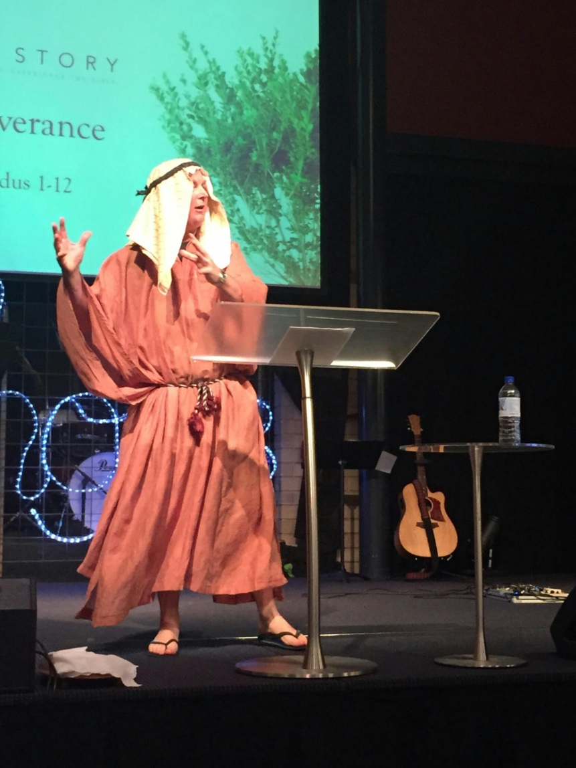
LAST WEEK in the Story…

Slide 4
Geography…

Slide 6
Chapter 5; “NEW COMMANDS and a NEW COVENANT

Slide 7
BIG IDEA
“God wants to dwell with you!”

Slide 8
I. How we Treat Each Other and God
Matthew 22:34 Hearing that Jesus had silenced the Sadducees, the Pharisees got together. 35 One of them, an expert in the law, tested him with this question: 36 “Teacher, which is the greatest commandment in the Law?”
37 Jesus replied: “ ‘Love the Lord your God with all your heart and with all your soul and with all your mind.’ i 38 This is the first and greatest commandment. 39 And the second is like it: ‘Love your neighbour as yourself.’ 40 All the Law and the Prophets hang on these two commandments.”

Slide 9
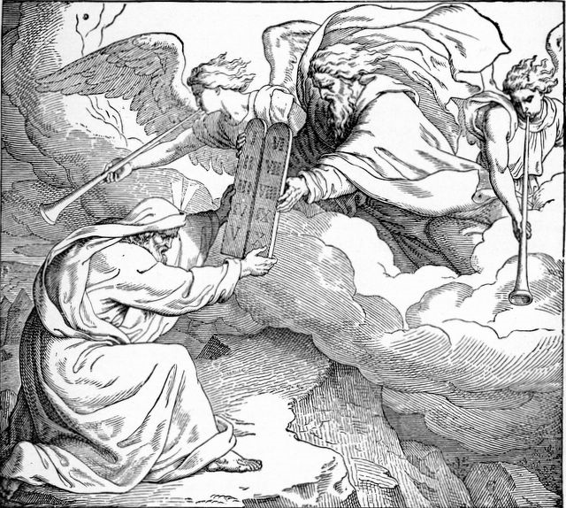
1st 4 Commandments guide how we treat God. Our Vertical relationship with GOD

Slide 10
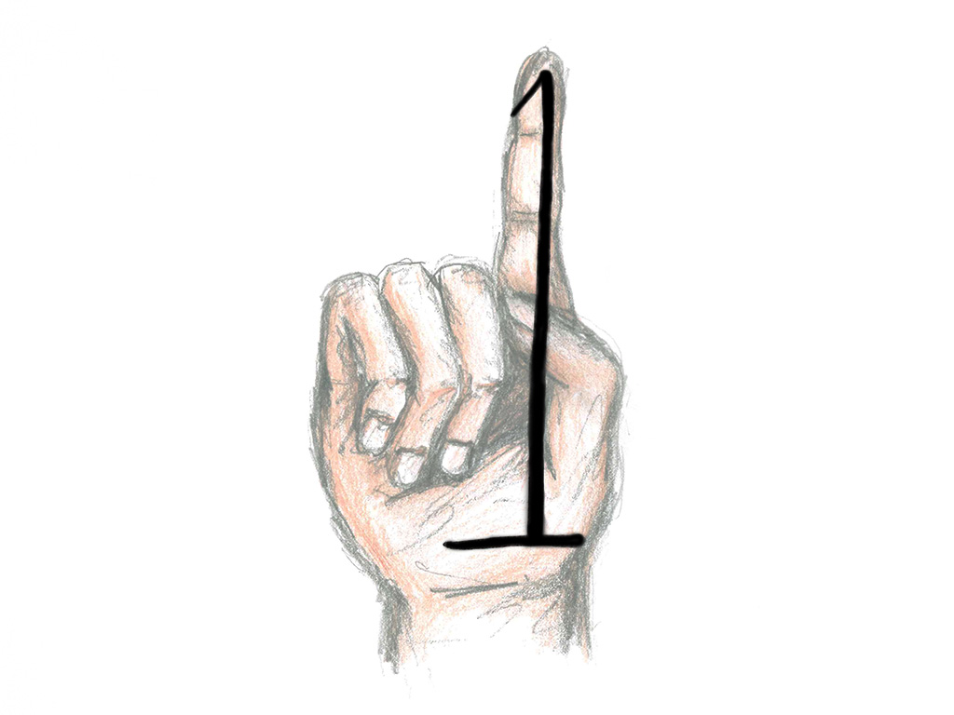
I. How we Treat Each Other and God
Insert the Commandments here…

Slide 11
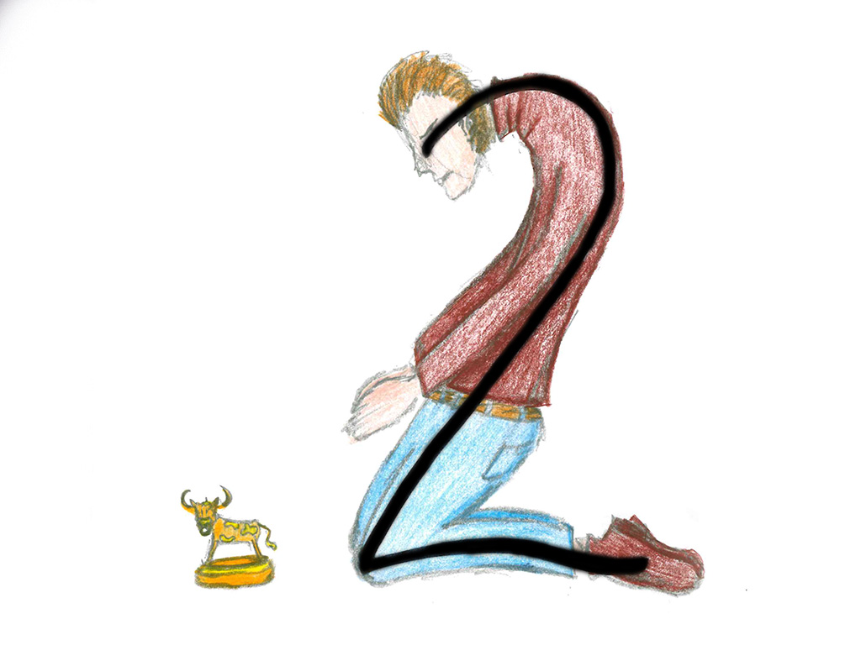

Slide 13
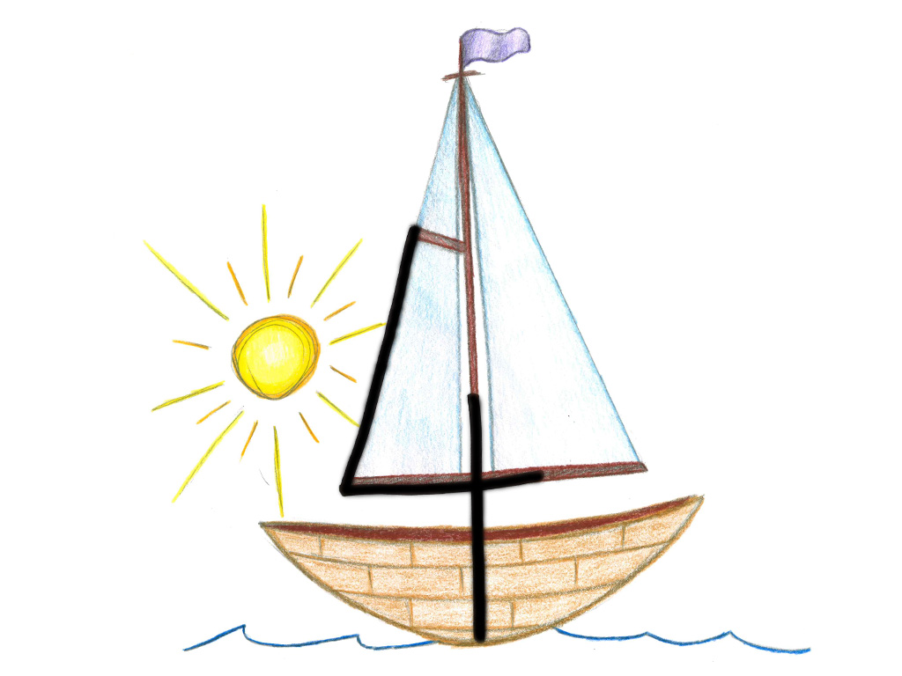

Slide 14
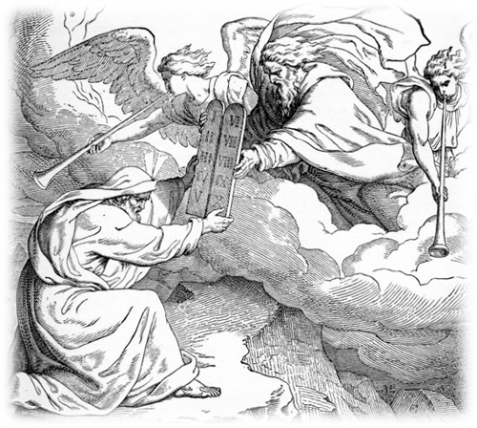
Commandments 5-10 guide how we treat other people. Our Horizontal relationships with each other

Slide 15
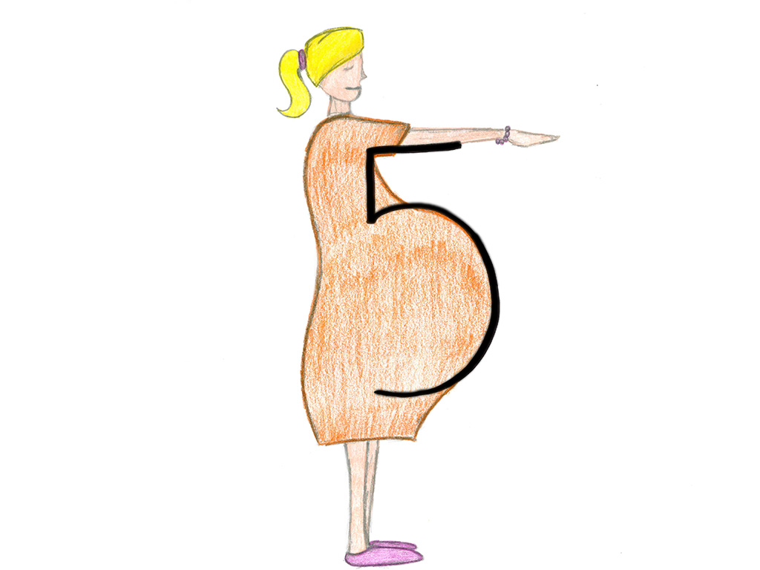

Slide 18
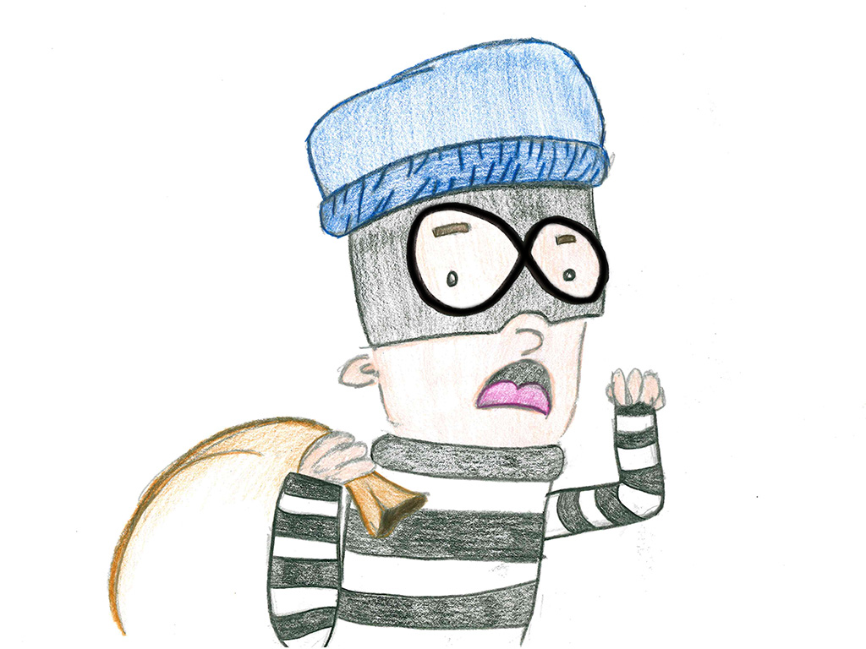

Slide 19
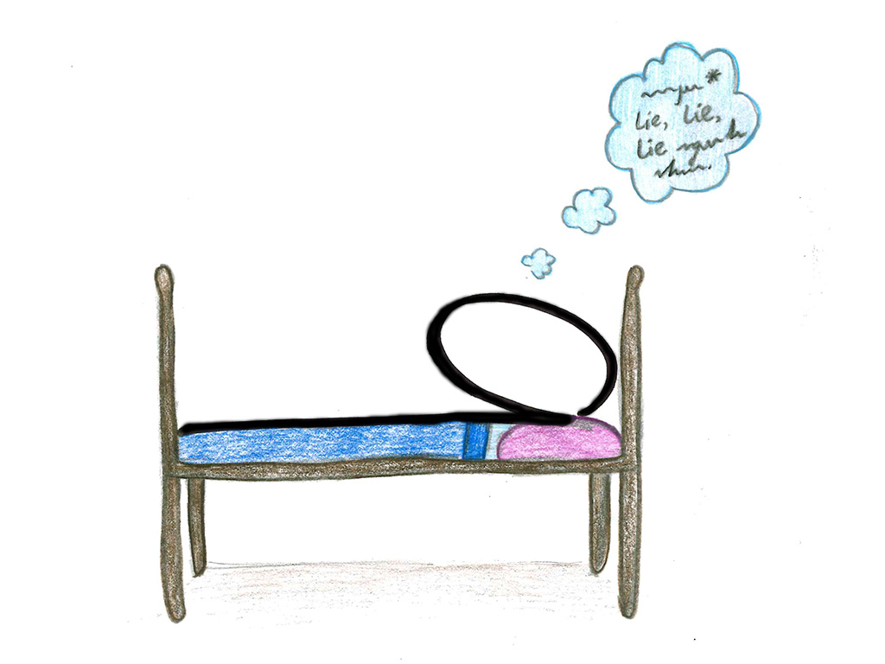

Slide 20
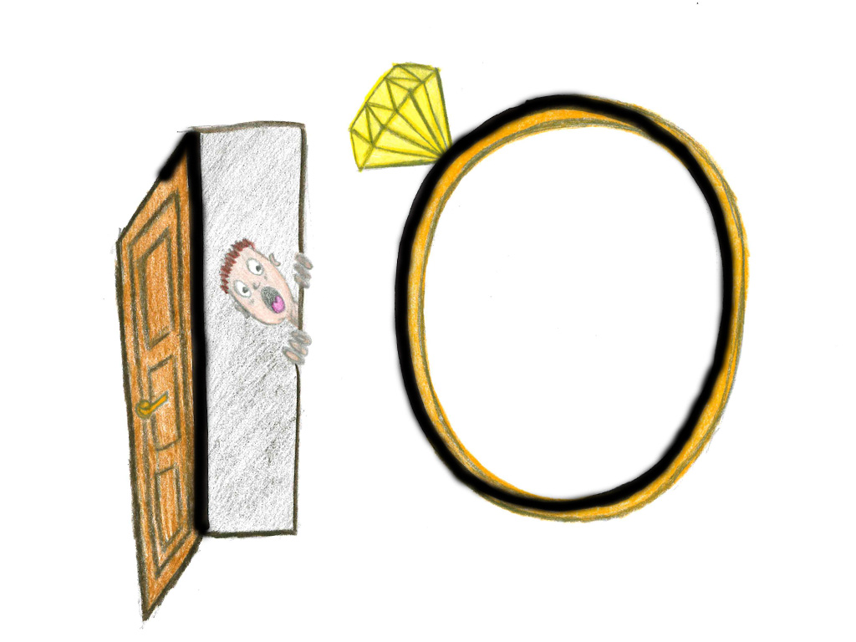

Slide 21
I. How we Treat Each Other and God
Exodus 24:3 When Moses went and told the people all the LORD’s words and laws, they responded with one voice, “Everything the LORD has said we will do.” 4 Moses then wrote down everything the LORD had said.

Slide 22
I. How we Treat Each Other and God
Exodus 24:12 The LORD said to Moses, “Come up to me on the mountain and stay here, and I will give you the tablets of stone with the law and commandments I have written for their instruction.”
13 Then Moses set out with Joshua his aide, and Moses went up on the mountain of God. 14 He said to the elders, “Wait here for us until we come back to you. Aaron and Hur are with you, and anyone involved in a dispute can go to them.”

Slide 23
I. How we Treat Each Other and God
15 When Moses went up on the mountain, the cloud covered it, 16 and the glory of the LORD settled on Mount Sinai. For six days the cloud covered the mountain, and on the seventh day the LORD called to Moses from within the cloud. 17 To the Israelites the glory of the LORD looked like a consuming fire on top of the mountain. 18 Then Moses entered the cloud as he went on up the mountain. And he stayed on the mountain forty days and forty nights.

Slide 24
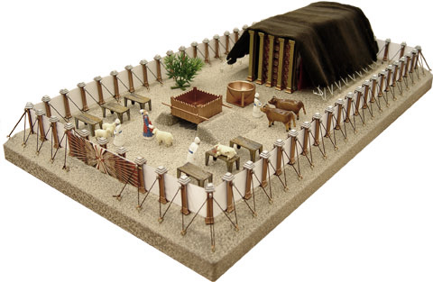
II. I will need a PLACE to DWELL
Exodus 25:8 “Then have them make a sanctuary for me, and I will dwell among them. 9 Make this tabernacle and all its furnishings exactly like the pattern I will show you.

Slide 25
II. I will need a PLACE to DWELL
Exodus 40:34 Then the cloud covered the tent of meeting, and the glory of the LORD filled the tabernacle. 35 Moses could not enter the tent of meeting because the cloud had settled on it, and the glory of the LORD filled the tabernacle.
36 In all the travels of the Israelites, whenever the cloud lifted from above the tabernacle, they would set out; 37 but if the cloud did not lift, they did not set out—until the day it lifted. 38 So the cloud of the LORD was over the tabernacle by day, and fire was in the cloud by night, in
the sight of all the Israelites during all their travels.

Slide 26
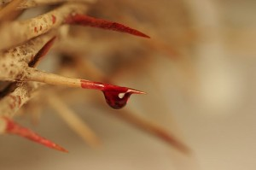
III. I will require SIN be ATONED for
Leviticus 17:11 For the life of a creature is in the blood, and I have given it to you to make atonement for yourselves on the altar; it is the blood that makes atonement for one’s life.

Slide 27
III. I will require SIN be ATONED for
Exodus 32:1 When the people saw that Moses was so long in coming down from the mountain, they gathered around Aaron and said, “Come, make us gods who will go before us. As for this fellow Moses who brought us up out of Egypt, we don’t know what has happened to him.”

Slide 28
III. I will require SIN be ATONED for
Exodus 32:19 When Moses approached the camp and saw the calf and the dancing, his anger burned and he threw the tablets out of his hands, breaking them to pieces at the foot of the mountain. 20 And he took the calf the people had made and burned it in the fire; then he ground it to powder, scattered it on the water and made the Israelites drink it.
21 He said to Aaron, “What did these people do to you, that you led them into such great sin?”
22 “Do not be angry, my lord,” Aaron answered. “You know how prone these people are to evil. 23 They said to me, ‘Make us gods who will go before us. As for this fellow Moses who brought us up out of Egypt, we don’t know what has happened to him.’ 24 So I told them, ‘Whoever has any gold jewellery, take it off.’ Then they gave me the gold,
and I threw it into the fire, and out came this calf!”

Slide 29
III. I will require SIN be ATONED for
Exodus 32:30 The next day Moses said to the people, “You have committed a great sin. But now I will go up to the LORD; perhaps I can make atonement for your sin.”
31 So Moses went back to the LORD and said, “Oh, what a great sin these people have committed! They have made themselves gods of gold. 32 But now, please forgive their sin—but if not, then blot me out of the book you have written.”
33 The LORD replied to Moses, “Whoever has sinned against me I will blot out of my book. 34 Now go, lead the people to the place I spoke of, and my angel will go before you. However, when the time comes for me to punish, I will punish them for
their sin.”

Slide 30
III. I will require SIN be ATONED for
Exodus 33:14 The LORD replied, “My Presence will go with you, and I will give you rest.”

Slide 31
3 Really Important Applications
YOUR SIN NEEDS TO BE ATONED FOR…
-Hebrews 10:1-18
WE ARE THE NEW TABERNACLE…
-1 Corinthians 3:16
GOD CHANGES US FROM THE INSIDE OUT…
-Matthew 22:38-40

